Slide 1
DDoS Detection and Mitigation in Software-Defined IoT Gateway
Prepared By:
Arun Kumar Nair
1867401, 3MTIT

Slide 2
Contents
Abstract
Literature Review
Research Gap
Problem Statement
Existing Architecture
Proposed Architecture
Methodology
Experimental Setup
Results / Comprison
Conclusion
Future Work
References
1

Slide 3
Abstract
The recent developments in IoT botnets contributes a major part in launching DDoS attacks on the IoT networks. IoT architecture lack basic security protocols, user interface, storage and computation power.
An IoT gateway device bridges the communication gap between IoT devices, sensors, equipment, systems and the cloud. Therefore in order to prevent such kind of cyber attack on the network the gateway must be secured.
In this project a Software-defined IoT gateway model is presented to provide a secured IoT gateway and then a DDoS detection and mitigation monitoring system is proposed to defend the network from DDoS attack.
The results has shown the presented gateway model is more efficient then the traditional gateway and the proposed algorithm detects and mitigate the attack with comparatively less resources.
2
Notes:
heterogenous in nature , deu to that more vulnerable to cyber attacks, DDoS is a major attack as its easy to create botnet army

Slide 4
Literature Review
S.No. | TITLE (Publication,Year) | AUTHORS | OBJECTIVE OF THE PAPER | KEY FINDINGS
1 | Early Detection of DDoS Attacks against SDN Controllers (IEEE,2015) | Seyed Mohammad Mousavi, Marc St-Hilaire | To detect DDoS attack in its early stages in an SDN controller. Introduce a effective and lightwieght algorithm to detect the attack. | Software-Defined Network, DDoS attack, Entropy method to detect DDoS, Mininet(tool).
2 | NFV Enabled IoT Architecture for an Operating Room Environment (IEEE,2018) | Igor Miladinovic, Sigrid Schefer-Wenzl | To provide a NFV enabled IoT architecture for operating room environment. | Virtualization of network functions, integrating NFV architecture with IoT network, using RESTful web API for southbound interface.
3 | Study on the IOT Architecture and Gateway Technology (IEEE,2015) | Chang-le Zhong, Zhen Zhu, Ren-gen Huang | To explain IoT architecture using five layer system and discuss how the gateway technology used as bridge between sensing and communication n/w. | In detailed architecture of IoT in four layers. IoT gateway.
3

Slide 5
Literature Review
S.No. | TITLE (Year) | AUTHORS | OBJECTIVE OF THE PAPER | KEY FINDINGS
4 | A survey of distributed denial-of-service attack, prevention, and mitigation techniques (International Journal of Distributed Sensor Networks,2017) | Tasnuva Mahjabin, Yang Xiao, Guang Sun, Wangdong Jiang | A survey of DDoS attack, prevention and mitigation techniques. Also covers the possible limitation and challenges of existing research. | Different types of attack, their motives, strategies and mechanisms. Different prevention and mitigation strategies.
5 | SDN-based Multi-Protocol Edge Switching for IoT Service Automation (IEEE,2018) | Mostafa Uddin, Sarit Mukherjee, Hyunseok Chang, T.V. Lakshman | A SDN based edge based multi-protocol architecture for large scale heterogeneous IoT deployment and service automation. | SDN for inter/intra protocol services. Rules based control system.
6 | Software-Defined IDS for Securing Embedded Mobile Devices (IEEE,2013) | Richard Skowyra, Sanaz Bahargam, Azer Bestavros | Learning Intrusion Detection System based on SDN. | OpenFlow protocol, Flow rules.
4

Slide 6
Literature Review
S.No. | TITLE (Year) | AUTHORS | OBJECTIVE OF THE PAPER | KEY FINDINGS
7 | A secured SDN framework for IoT (IEEE,2015) | Kshira Sagar Sahoo, Bibhudatta Sahoo, Abinas Panda | To address the security challenges in SDN and propose a secure framework for IoT based on SDN. | SDN architecture and different layers, Security issues in SDN,
8 | An Entropy-Based Distributed DDoS Detection Mechanism in Software-Defined Networking (IEEE,2015) | Rui Wang, Zhiping Jia, Lei Ju | To design a flow statistics process in switch to detect DDoS attack based on entropy. | Entropy to detect ddos,Open vSwitch,
9 | Combining OpenFlow and sFlow for an effective and scalable anomaly Detection and mitigation mechanism on SDN environments (Elsevier,2013) | K. Giotis, C. Argyropoulos, G. Androulidakis ⇑ , D. Kalogeras, V. Maglari | To present a combined mechanism for reduced data gathering, anamoly detection basedon entropy and network-wide anamoly detection using OF. | Flow counters data collection for periodic analysis, sFlow, different parameters for entropy based classification.
5

Slide 7
Literature Review
S.No. | TITLE (Year) | AUTHORS | OBJECTIVE OF THE PAPER | KEY FINDINGS
10 | Mitigation of DDoS attack instigated by compromised switches on SDN controller by analyzing the flow rule request traffic (IJET,2018) | Sanjeetha R, Shikhar Srivastava, Rishab Pokharna, Syed Shafiq, Dr. Anita Kanavalli | To show DDoS attack using Flow-entry tables of switches and way to mitigate it. | Using Flow-entries as vulnerability for DDoS attack.
11 | A New Multi Classifier System using Entropy-based Features in DDoS Attack Detection (IEEE,2018) | Abigail Koay, Aaron Chen, Ian Welch, Winston K.G. Seah | To propose a multi-classifier system to detect DDoS based on the proposed set of multiple entropy based feature and machine learning classifier to increase accuracy. | Entropy, multiple classfier system, machine learning to classify traffic.
12 | Cloud based IOT : Architecture, Application, Challenges and Future (IJSRCSEIT,2018) | Zeba Qureshi, Nupur Agrawal, Deepika Chouhan | To provide an overview of an cloud based architecture for integration of IoT with Cloud Computing. | The basic architecture of cloud and IoT, Benefits, Challenges and various application of Cloud based IoT.
6

Slide 8
Research Gap (Base paper)
Controller in proposed architecture is vulnerable to DDoS attack.
An attacker can forge SRC_IP or DST_IP to generate the attack.
Generating huge no. of packet with forged IP address will flood the controller and lead to Denial-of-Service.
The proposed architecture has only detection module with no method to mitigate the attack.
7

Slide 9
Problem Statement
Using Software-Defined Network (SDN) framework to implement a secure gateway for IoT networks. To implement an efficient algorithm to identify the forged IP addresses and detect the source of illegitimate traffic. To mitigate the attack using OpenFlow flow entries.
9

Slide 10
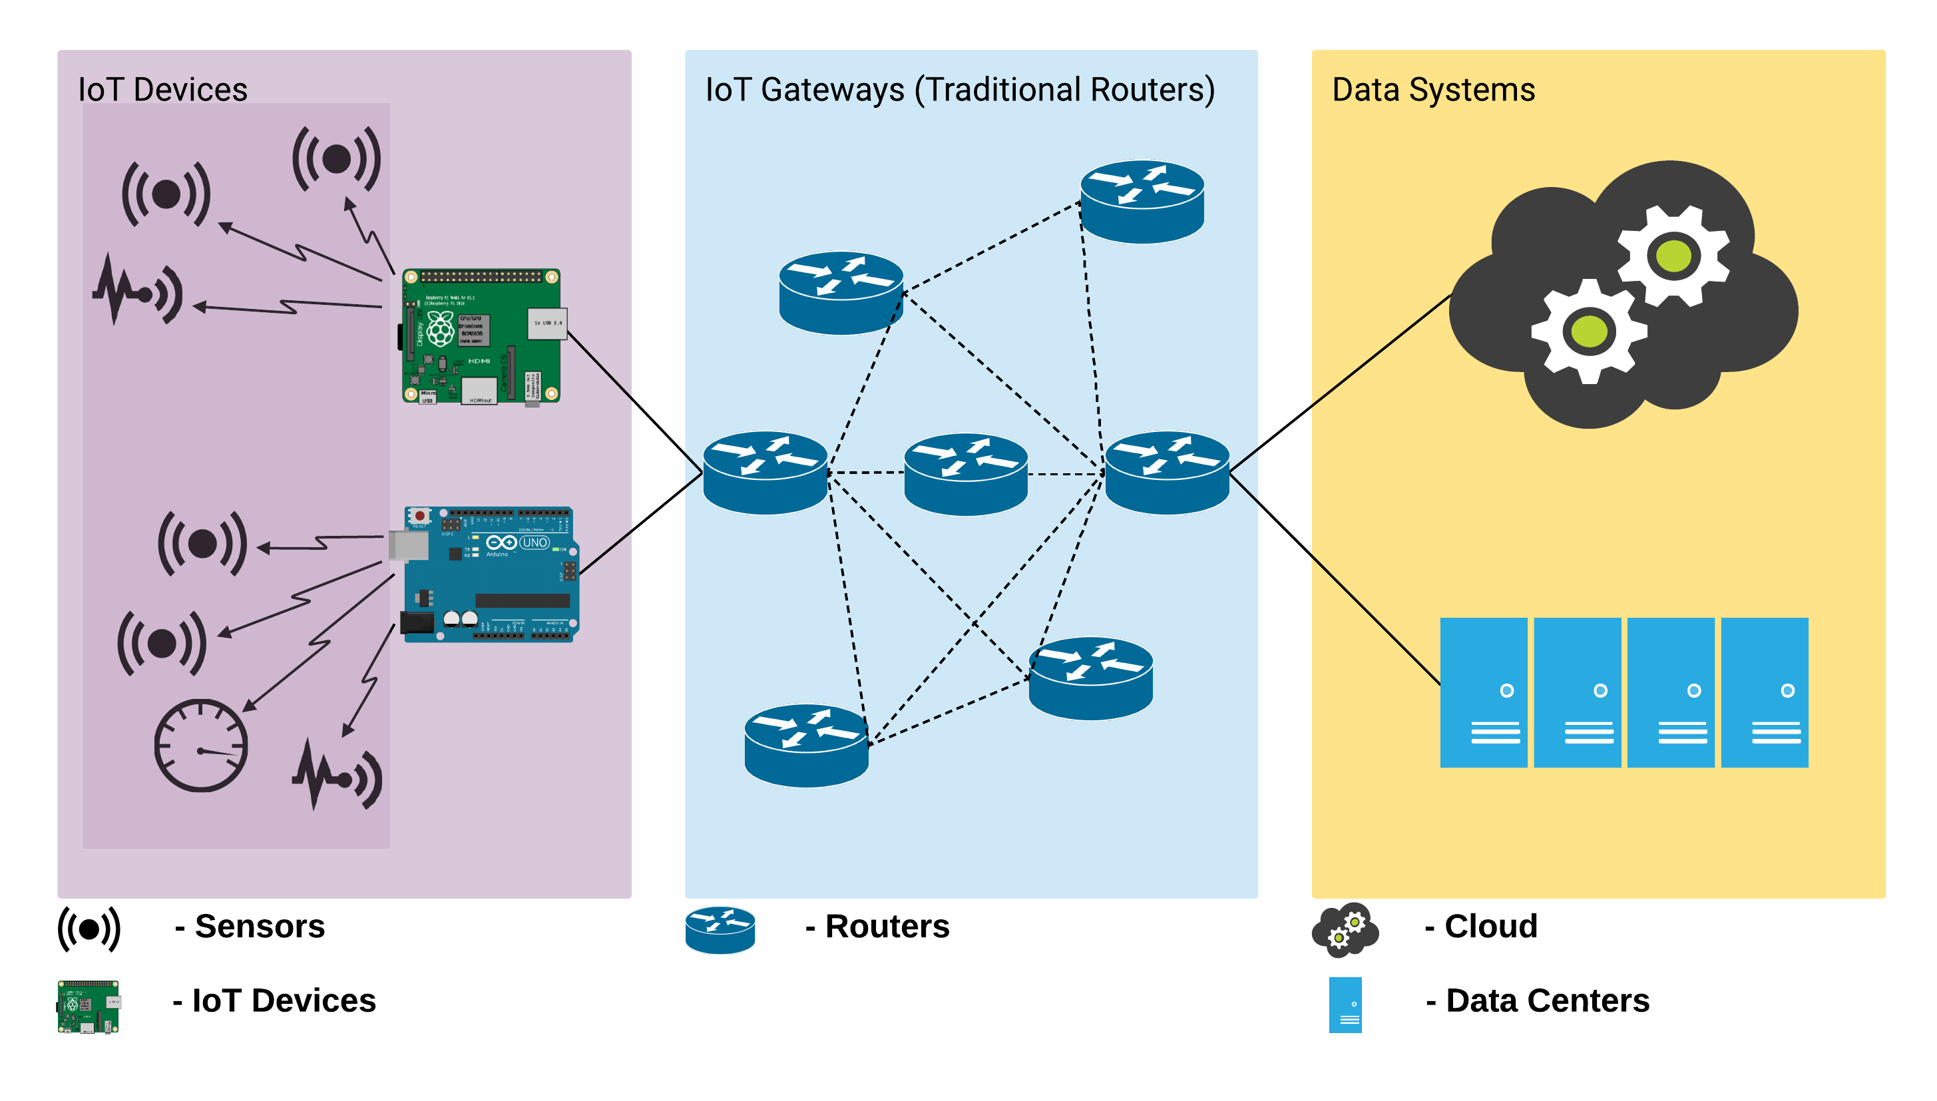
Architecture (Traditional Architecture)
8

Slide 11
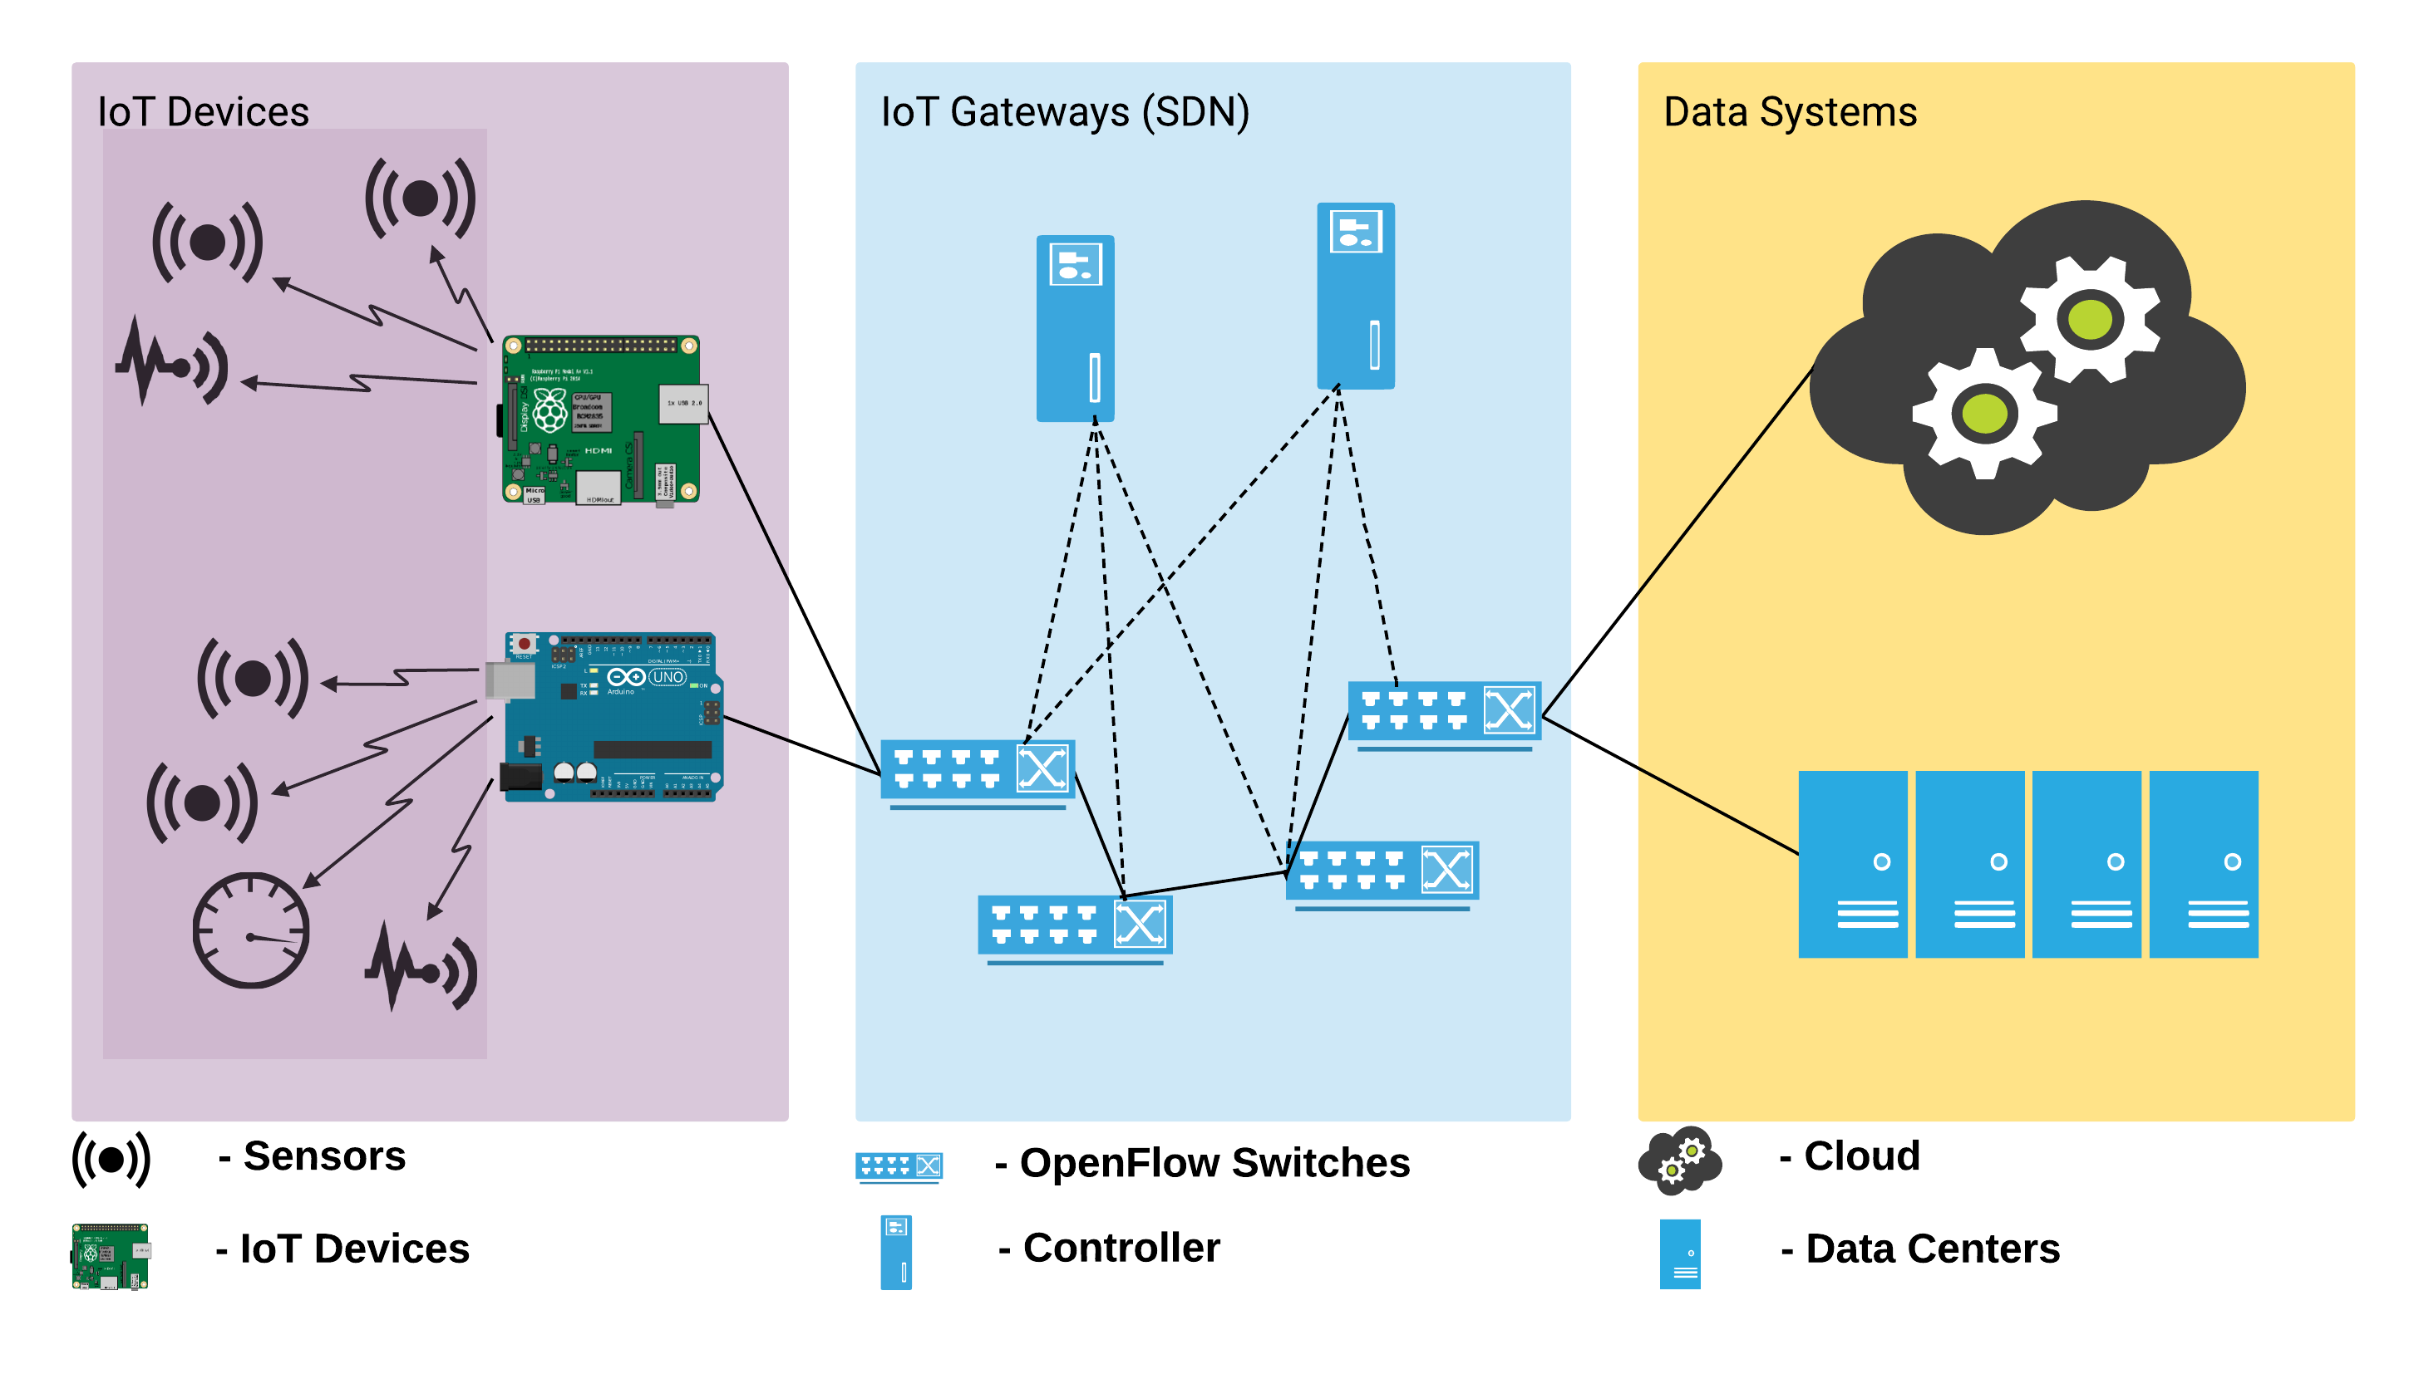
Architecture (Proposed SDN Architecture)
10

Slide 12
Methodology
MODULE I (creating model)
Implement SDN as IoT gateway.
Creating a topology for simulation.
Creating scripts to generate traffic.
MODULE II (Simulation)
Simulating the given topology with NORMAL traffic.
Simulating the given topology with ATTACK traffic.
Analyzing and comparing the recorded traffic.
11

Slide 13
Methodology
MODULE III (Trigger)
For consecutive packet calculate ∆T using equation (1).
∆T = T_{i} - T_{i+1} - (1)
In window size of n connections
for more than 1/4th of total connections:
if ∆T < T_{th} :
than call detection module (Module IV)
12

Slide 14
Methodology
MODULE IV (Detection module)
Sample of n connections.
If one MAC_ADDR associated with more than one SRC_IP then header information is forged.
Call mitigation module (module V).
If one SRC_IP associated with more than m% DST_IP of total connections than header information is forged.
Call mitigation module (module V).
MODULE V (Mitigation module)
Block the traffic from the MAC_ADDR by installing the required FLOW_ENTRY.
Block the trafic from the MAC_ADDR or SRC_IP by installing the required FLOW_ENTRY.
*n is the window size
*m is the threshold percentage, the best possible value obtained after large no of experimenting.
13

Slide 15
Experimental Setup
SDN controller (virtual machine with configuration of 1GHz, 2GB memory, Fast Ethernet interface, and Ubuntu 16.04 as OS).
Topology (virtual machine with configuration of 2.20GHz, 4GB memory, and Fast Ethernet interface, and Ubuntu 16.04 as OS).
Mininet ( to create IoT topology of 10 IoT devices, 3 switches and 1 controller ).
POX Controller ( networking software platform written in Python)
Python Scapy ( to generate normal and attack traffic).
Wireshark ( for collection and analysis of network data).
14

Slide 16
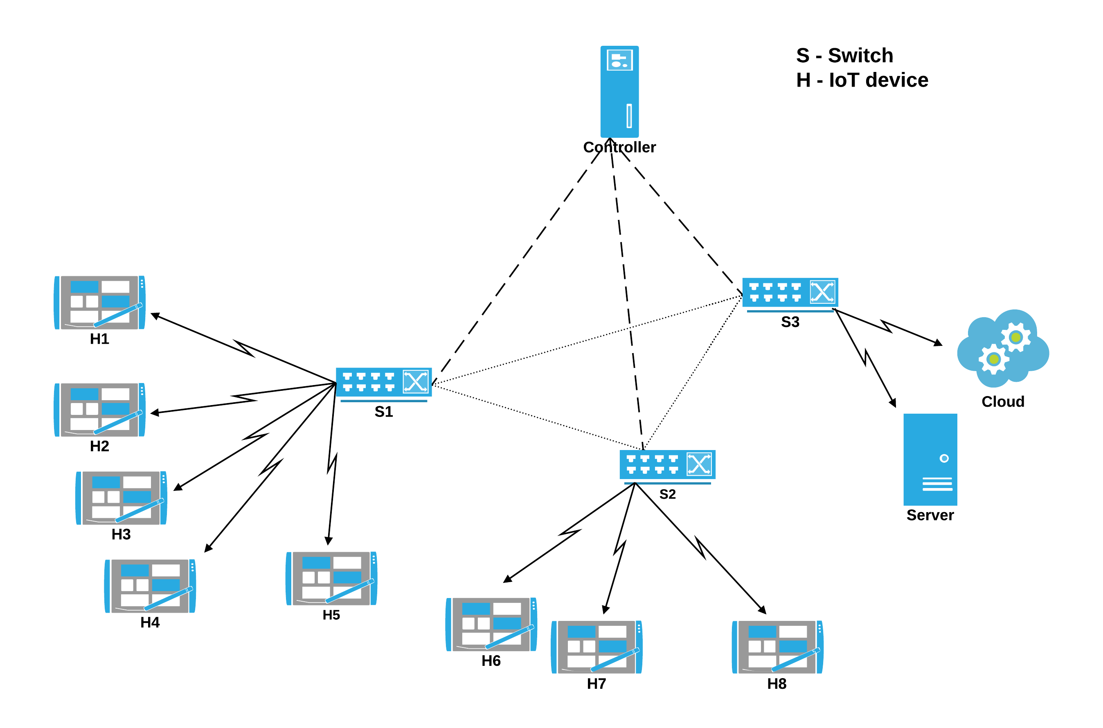
Experimental Setup(Topology)
15

Slide 17
Result
After simulating the given topolgoy, we understood that how,
Packet traverse in SDN network.
Controller issue flow entries and different fields in a flow entry.
OpenFlow protocol works.
Packet traversal after flow entry is installed.
Traffic is generated using Python Scapy library.
The controller response under NORMAL traffic.
The controller response under ATTAck traffic.
The proposed algorithm detects the attack network.
OpenFlow entries are used to mitigate the attack.
16

Slide 18
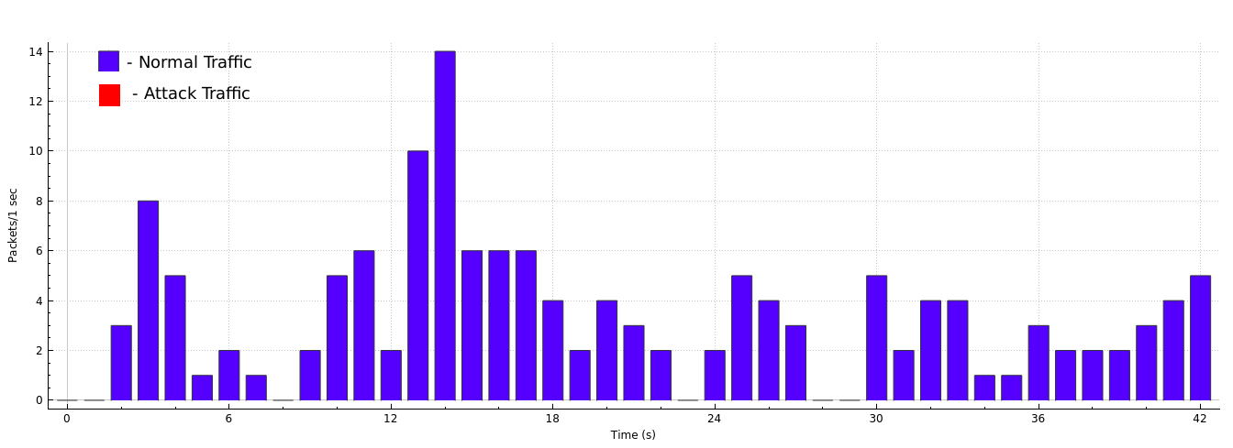
Result (Graph - Normal Traffic)
17

Slide 19
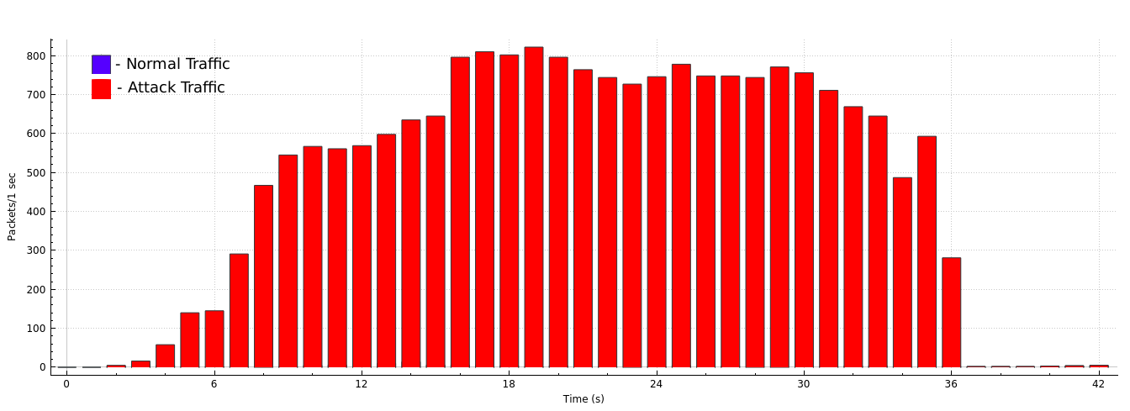
Result (Graph - Attack Traffic)
18

Slide 20
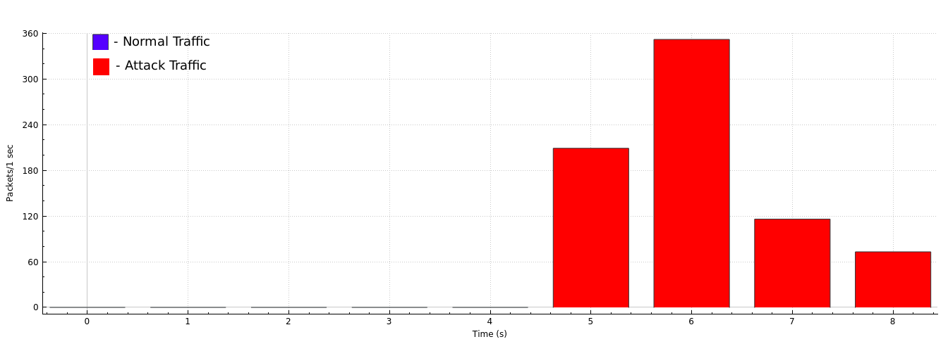
Result (Graph - Attack Traffic with Prevention, Entropy algorithm)
19

Slide 21
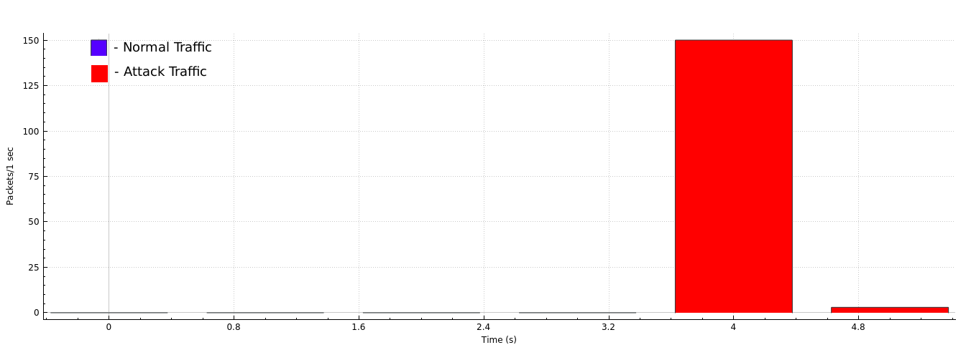
Result (Graph - Attack Traffic with Prevention, Association algorithm)
20

Slide 22
Result (Comparison Table)
 | ENTROPY METHOD |  | ASSOCIATION METHOD
ATTACK TRAFFIC TO NORMAL TRAFFIC RATIO | Total Packets | Detection and Mitigation Time | Total Packets | Detection and Mitigation Time
25% | 602 | 4 | 36 | 2
50% | 548 | 6 | 77 | 2
75% | 615 | 8 | 70 | 6
100% | 750 | 4 | 122 | 2

Slide 23
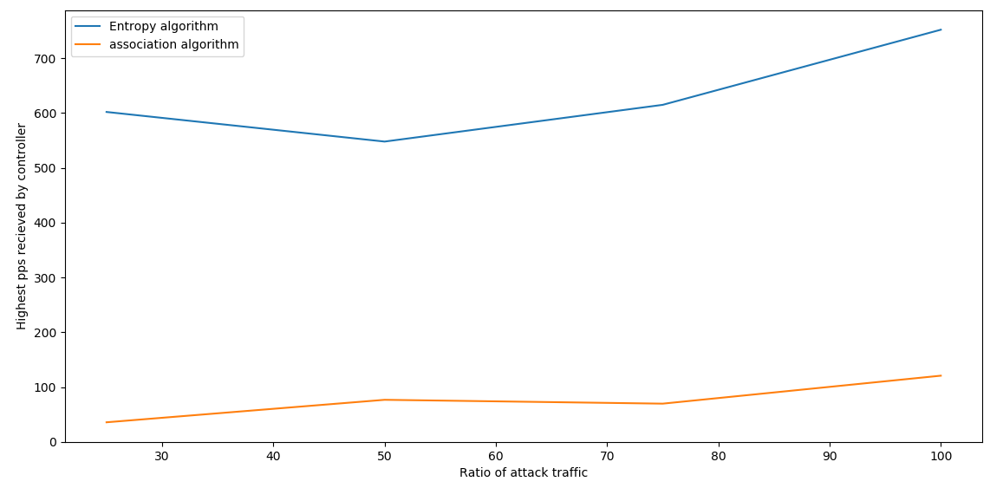
Result (Packet comparison)
21

Slide 24
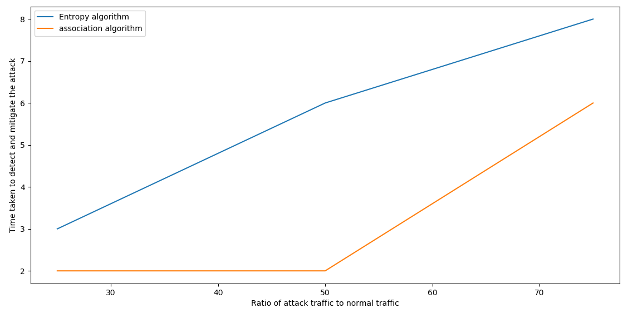
Result (Time comparison)
22

Slide 25
Conclusion
In this project we present a generic framework to secure IoT network using SDN as IoT gateway.Also a new method for the detection and mitigation of DDoS attack in the same.
The proposed method calculates the no. of DST_IP associated with single SRC_IP and no. of SRC_IP associated with a single MAC_ADDR. Then it compares the calculated values with the threshold values and installs required flow entries accordingly.
The results from the simulations shown that the proposed methodology is effective for detecting the attack in a shorter period of time and using minimal no. of packets. After detection the attack is successfully mitigated using flow entries.
23

Slide 26
Future Work
The presented work is limited to the network layer that is, it only consider Internet Protocol as a feature for detection of attack. In future, this research can be extended for the inclusion of feature from other layers as well, like MAC address in the data link layer.
In addition a load balancing module can be implemented on a pool of controller to further distribute the risk and efficiently handle the traffic to the controller.
24

Slide 27
References
1.Mousavi, S. M., & St-Hilaire, M. (2015, February). Early detection of DDoS attacks against SDN controllers. In 2015 International Conference on Computing, Networking and Communications (ICNC) (pp. 77-81). IEEE.
2. Miladinovic, I., & Schefer-Wenzl, S. (2018, February). NFV enabled IoT architecture for an operating room environment. In 2018 IEEE 4th World Forum on Internet of Things (WF-IoT) (pp. 98-102). IEEE.
3. Zhong, C. L., Zhu, Z., & Huang, R. G. (2015, August). Study on the IOT architecture and gateway technology. In 2015 14th International Symposium on Distributed Computing and Applications for Business Engineering and Science (DCABES) (pp. 196-199). IEEE.
25

Slide 28
References
4. Mahjabin, T., Xiao, Y., Sun, G., & Jiang, W. (2017). A survey of distributed denial-of-service attack, prevention, and mitigation techniques. International Journal of Distributed Sensor Networks, 13(12), 1550147717741463.
5. Uddin, M., Mukherjee, S., Chang, H., & Lakshman, T. V. (2018). Sdn-based multi-protocol edge switching for iot service automation. IEEE Journal on Selected Areas in Communications, 36(12), 2775-2786.
6. Skowyra, R., Bahargam, S., & Bestavros, A. (2013, September). Software-defined ids for securing embedded mobile devices. In 2013 IEEE High Performance Extreme Computing Conference (HPEC) (pp. 1-7). IEEE.
26

Slide 29
References
7. Sahoo, K. S., Sahoo, B., & Panda, A. (2015, December). A secured SDN framework for IoT. In 2015 International Conference on Man and Machine Interfacing (MAMI) (pp. 1-4). IEEE.
8. Wang, R., Jia, Z., & Ju, L. (2015, August). An entropy-based distributed DDoS detection mechanism in software-defined networking. In 2015 IEEE Trustcom/BigDataSE/ISPA (Vol. 1, pp. 310-317). IEEE.
9. Giotis, K., Argyropoulos, C., Androulidakis, G., Kalogeras, D., & Maglaris, V. (2014). Combining OpenFlow and sFlow for an effective and scalable anomaly detection and mitigation mechanism on SDN environments. Computer Networks, 62, 122-136.
27

Slide 30
References
10. Raja, Sanjeetha & Srivastava, Shikhar & Pokharna, Rishab & Shafiq, Syed & Kanavalli, Dr. (2018). Mitigation of DDoS attack instigated by compromised switches on SDN controller by analyzing the flow rule request traffic. International Journal of Engineering & Technology. 7. 46. 10.14419/ijet.v7i2.6.10065.
11. Koay, A., Chen, A., Welch, I., & Seah, W. K. (2018, January). A new multi classifier system using entropy-based features in DDoS attack detection. In 2018 International Conference on Information Networking (ICOIN) (pp. 162-167). IEEE.
12. Qureshi, Z., Agrawal, N., & Chouhan, D. (2018). Cloud based IOT: Architecture, Application, Challenges and Future. International Journal of Scientific Research in Computer Science, Engineering and Information Technology, 3, 359-368.
28

Slide 31

30

